Slide 1
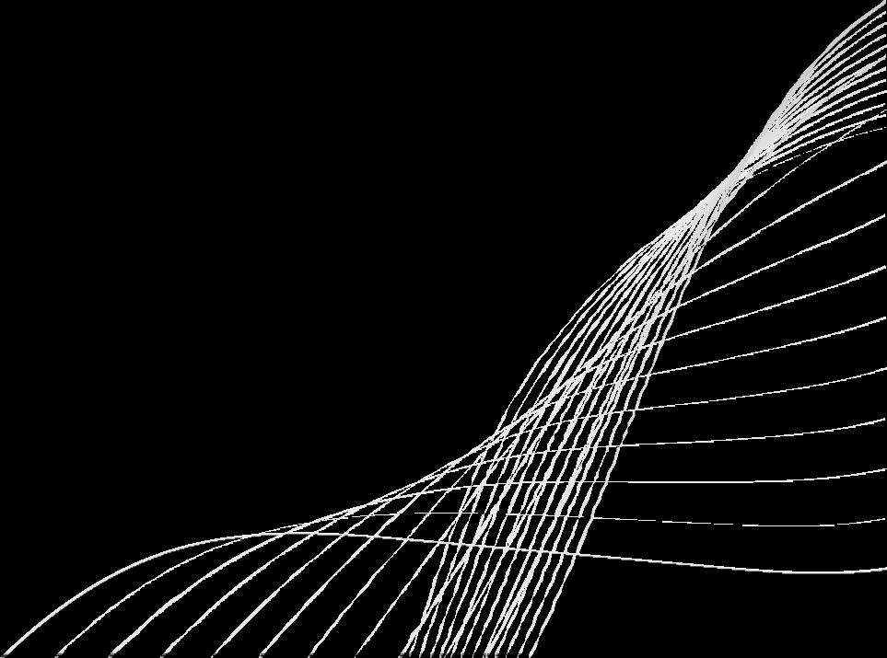
INTRODUCTION TO STREAMLIT
Python → Web Apps, Instantly
P R E S E N T E D B Y C H . G A Y A T R I

Slide 2

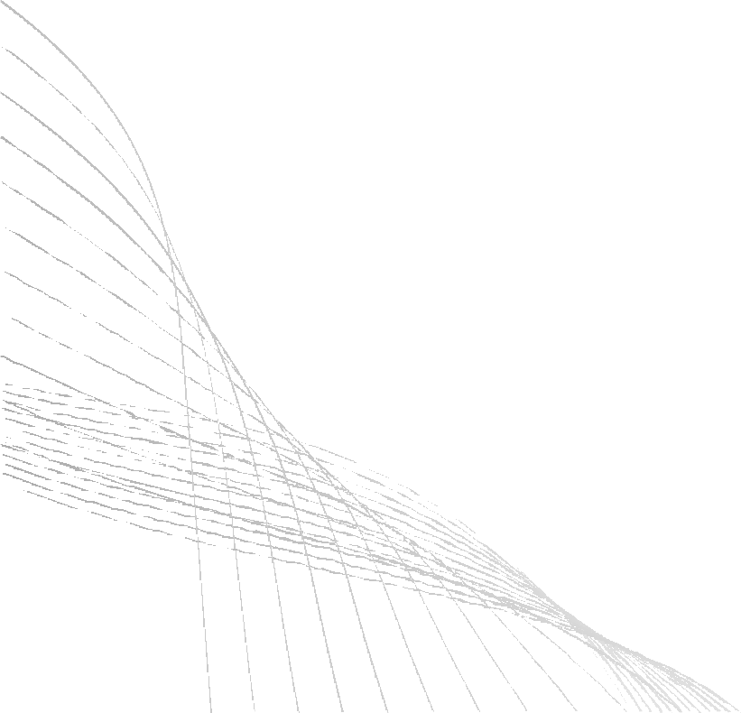
WHAT IS STREAMLIT?
Open-source Python library
Builds web apps directly from Python scripts Designed for data science, ML, and dashboards No web development needed (no HTML/CSS/JS)

Slide 3
WHY STREAMLIT?
⚡ Turn code → apps in minutes
🧑‍💻 Beginner-friendly, no steep learning curve
🎛 Interactive widgets (sliders, buttons, uploaders)
📊 Works with Python libraries: pandas, matplotlib,

Slide 4
INSTALLATION
install python(3.8+) Run in terminal:
pip install streamlit
Test with:
streamlit hello

Slide 5
DEMO CODE
python
import streamlit as st st.title(“Hello streamlit”)
name=st.text_input(“Enter your name) st.write(“Hello”,name)

Slide 6

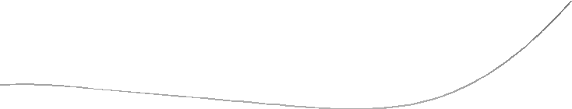














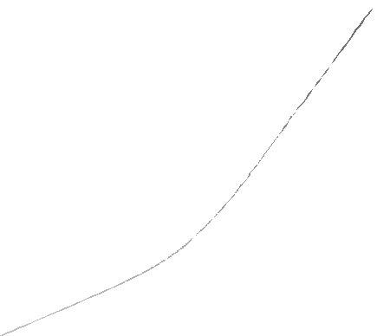






ADVANTAGES
Beginner-friendly (no web dev required)
Fast prototyping (minutes, not weeks) Great for AI/ML model demos
Easy to share with teams Open-source & free

Slide 7
LIMITATIONS
-Limited UI customization
Not for large-scale enterprise apps
Can struggle with very large datasets
Python only (not multi- language)

Slide 8
REAL USE CASES
📈 Data dashboards (finance, healthcare, IoT)
🤖 AI/ML model showcases (chatbots, image recognition)
🏫 Teaching & training (students learn by building
apps)
🚀 Quick internal tools for teams & startups

Slide 9
DEPLOYMENT
-streamlit cloud(1-click free hosting)
-or deploy via AWS,Azure,Gcp,Docker
-share app link->anyone can access in browser

Slide 10
CONCLUSION
Streamlit = Python → Interactive Web Apps Perfect for beginners, data scientists, and AI demos
Simple, powerful, open-source

Slide 11
THANK YOU
10

